Slide 1
Details for Hic heat maps

Slide 2
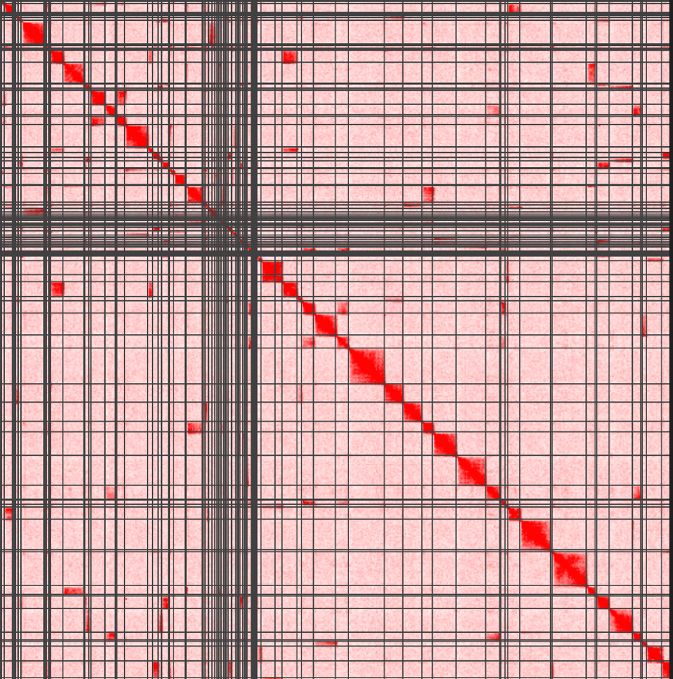
Hi-C contact map (heatmap) generation
Contigs
Hi-C reads
Contigs
BWA mapping & samtools sorting
Agp2assembly.py
Mapping file
Matlock to extract and sort information
Contig information file
R1 & R2 links
Run-assembly-visualizer.sh
‘.hic’ file used for generating heatmap
JuiceBox
Hi-C contact map

Slide 3
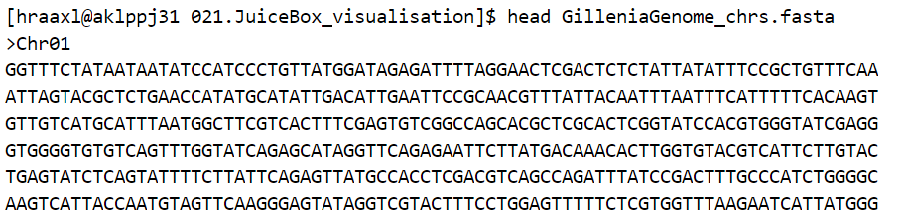
Hi-C contact map (heatmap) generation
Input file 1 – genomic sequences (contigs)
Contigs that were generated from several assembling steps from raw whole-genome sequencing reads
Contigs that are required to be post-scaffolded using Hi-C data to chromosomal level
Can be hundreds or thousands of contigs
Length can vary, usually longer than 10kb
“.Fasta” file
Example: “head xxx.fasta” to
print out the first 10 lines:
Header (sequence ID)
Genomic sequence

Slide 4
Hi-C contact map (heatmap) generation
Hi-C reads
Contigs
Hi-C reads
Contigs
BWA mapping & samtools sorting
Agp2assembly.py
Mapping file
Matlock to extract and sort information
Contig information file
R1 & R2 links
Run-assembly-visualizer.sh
‘.hic’ file used for generating heatmap
JuiceBox
Hi-C contact map

Slide 5
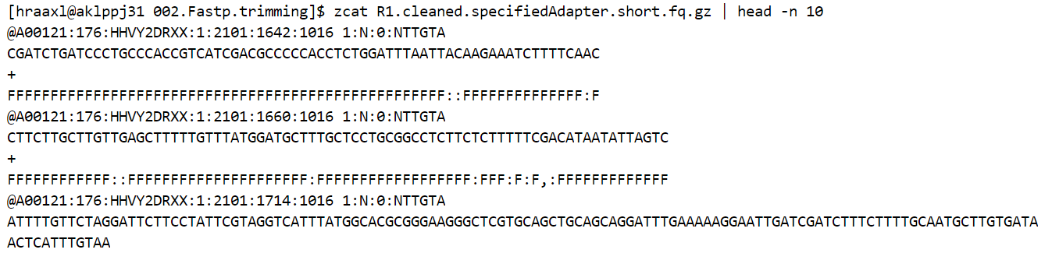
Hi-C contact map (heatmap) generation
Input file 2 – Hi-C read sequences (R1 & R2 files)
Data are used to scaffold genomic sequences
Can be millions/billions of sequences
Length is 150 bases
“.fastq.gz” file
Example: “zcat .fq.gz | head -n 10” to
Print out the first 10 lines:
Header (read ID)
Read sequence

Slide 6
Hi-C contact map (heatmap) generation
Hi-C reads
Contigs
Hi-C reads
Contigs
BWA mapping & samtools sorting
Agp2assembly.py
Mapping file
Mapping file
Matlock to extract and sort information
Contig information file
R1 & R2 links
Run-assembly-visualizer.sh
‘.hic’ file used for generating heatmap
JuiceBox
Hi-C contact map

Slide 7
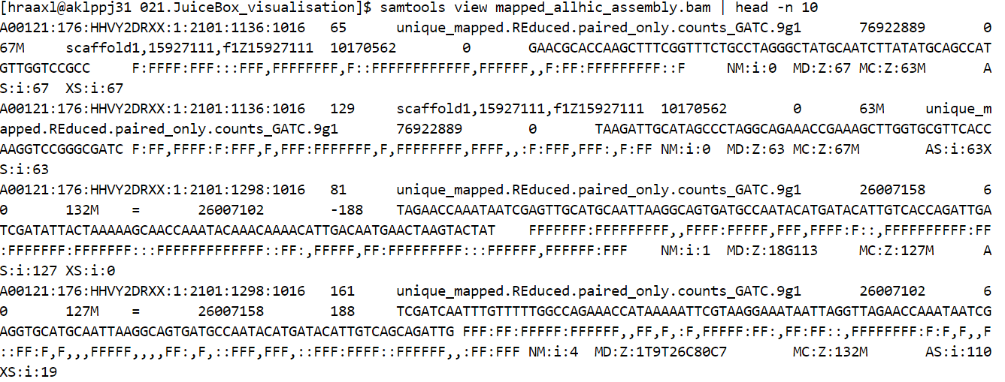
Hi-C contact map (heatmap) generation
Output file from alignning Hi-C reads to the genomic sequences
BWA mapper is usually used to align Hi-C reads
Every read will be found with the best matching region on the genomic sequences
“.bam” file
Example: “samtools view .bam | head -n 10” to
Print out the first 10 lines:
R1 read ID
read length
Contig ID
R 1 Location (start)
R2 location (start)

Slide 8
Hi-C contact map (heatmap) generation
Hi-C reads
Contigs
Hi-C reads
Contigs
BWA mapping & samtools sorting
Agp2assembly.py
Mapping file
Mapping file
Matlock to extract and sort information
Contig information file
R1 & R2 links
R1 & R2 links
Run-assembly-visualizer.sh
‘.hic’ file used for generating heatmap
JuiceBox
Hi-C contact map

Slide 9
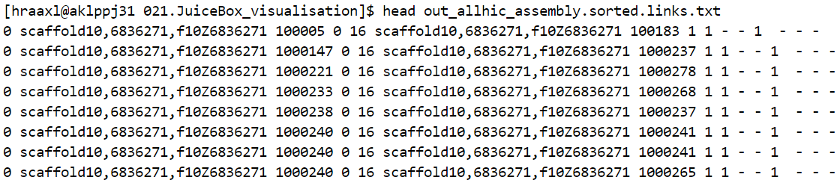
Hi-C contact map (heatmap) generation
Extract R1 & R2 link information from ’.bam’ file
‘.sort.out.txt’ file
Each R1 and R2 pair has the mapped positions stored at one row that easily represent one genomic interaction/link
Example: “head” to
Print out the first 10 lines:
Contig ID for mapped R1
R 1 Location (start)
Contig ID for mapped R2
R 2 Location (start)

Slide 10
Hi-C contact map (heatmap) generation
Hi-C reads
Contigs
Hi-C reads
Contigs
BWA mapping & samtools sorting
Agp2assembly.py
Mapping file
Mapping file
Matlock to extract and sort information
Contig information file
Contig information file
R1 & R2 links
R1 & R2 links
Run-assembly-visualizer.sh
‘.hic’ file used for generating heatmap
JuiceBox
Hi-C contact map

Slide 11
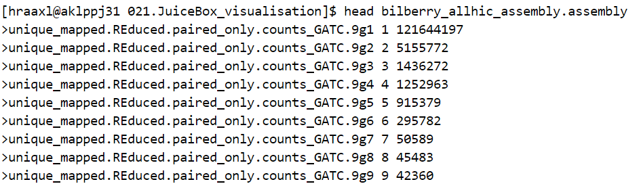
Hi-C contact map (heatmap) generation
Generating contig file information
‘.assembly’ file
Example: “head” to
Print out the first 10 lines:
Contig ID
Contig length

Slide 12
Hi-C contact map (heatmap) generation
Hi-C reads
Contigs
Hi-C reads
Contigs
BWA mapping & samtools sorting
Agp2assembly.py
Mapping file
Mapping file
Matlock to extract and sort information
Contig information file
Contig information file
R1 & R2 links
R1 & R2 links
Run-assembly-visualizer.sh
‘.hic’ file used for generating heatmap
‘.hic’ file used for generating heatmap
JuiceBox
Hi-C contact map
Hi-C contact map

Slide 13
Dots on heatmap
The R1 & R2 link file (.hic) only has the start mapped locations for R1 & R2
The closer the mapped R1 & R2 are, the closer the dot is to the diagonal
in biology, R1 & R2 that are close together are more likely to be linked
A lot more dots are sitting close to the diagonal, indicating much higher frequency of interactions between the genomic regions that are close to each other
Contig 1: AATTCTACGCCGTCGT……AATTCCGGTGTGAC (length of 10kb)
R1: ATTCCGG
R2: TCCACGC
0
Start: 2k
R1
Contig 1
Start: 7k
R2
Contig 1
10k
0
R1
R2
10k

Slide 14
Hi-C heatmap of contigs
Example from fish Hi-C mapped data
Contigs resulted from assembling raw sequencing reads
Contigs are placed with random order and orientation at y-xis, same order and orientation at x-xis (from left to right)
Grey/black line separates the two contigs on the map
Strong signals (red squares) can be seen due to frequent contacts between the two contigs

Slide 15
Extract contigs based on interaction signals
Contig102
Contig457
Cluster x (pseudochr x)
……
Cluster 2 (pseudochr 2)
Cluster 1 (pseudochr 1)
Contig93
Select the best heatmap
Re-order and re-orientate separately
Run the whole process more than once if necessary
Combine and regenerate Hi-C map on all clusters to check.

Slide 16
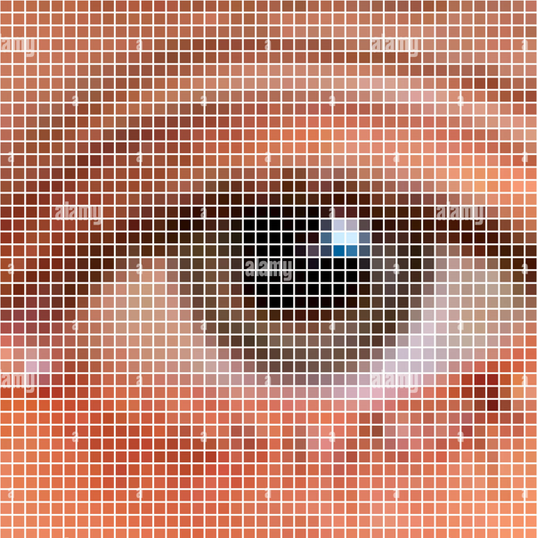
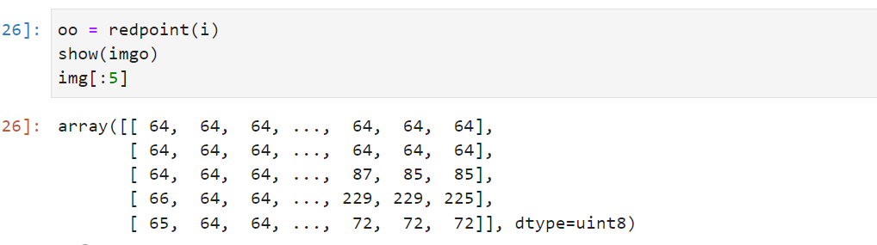
Composition of the image
All images are made up of pixel dots，as shown in this image each small square is a pixel
Pixel points are stored in a matrix with values from 0-255
The usual picture is therefore made up of three or four matrix filled with values from 0-255.

Slide 17
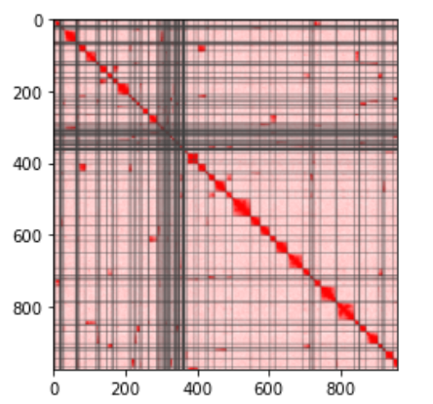
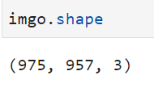
The HIC heatmap has 975 rows and 957 columns of pixels
three-channel image, with a 975*957 matrix
There are 16777216 (256*256*256)combination colors

Slide 18
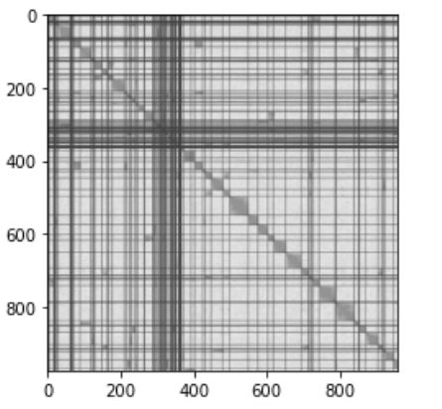
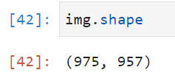
Some image processing algorithms only accept single channel images for processing
colour images contain so much information and a single channel matrix is much easier to process than a three channel
many packaged opencv functions only accept greyscale images as input
There is only one matrix, a 975*957 matrix of 0-255, where 0 is black, 255 is white and the middle is a varying shade of grey

Slide 19
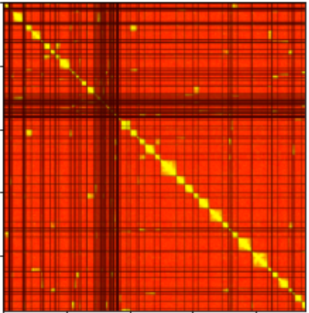
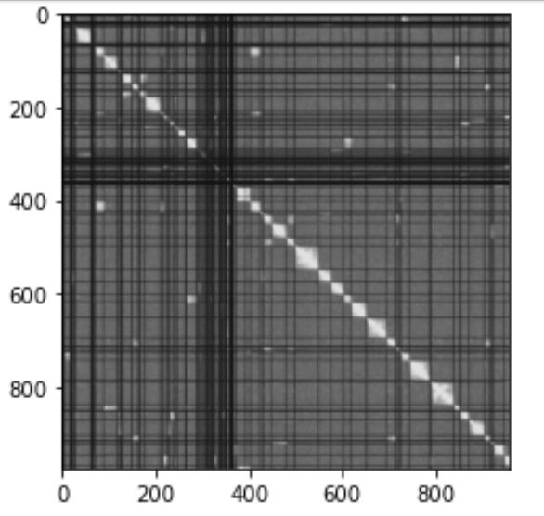
HSV
The greyed-out areas of the interactions and the gapped lines are too similar in colour, so they look cluttered.
simply means that the colours are highlighted and then greyed out afterwards to make it much clearer

Slide 20
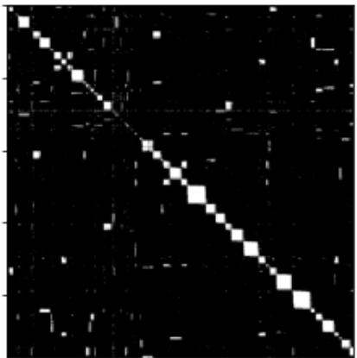
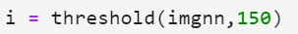
Binarization
sometimes even after greyscale the image information is still too much or difficult to calculate so there is a binarization operation.
All pixels of the image are grouped into 0 or 255 and no other colours.
This is simply done by setting the threshold to a value between 0 and 255, with anything above this value being set to white and anything below to black.

Slide 21
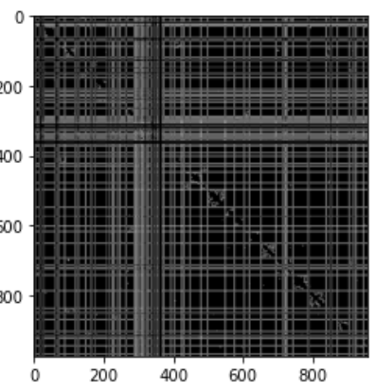
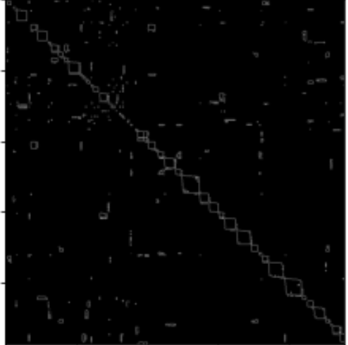
Border detection
Many image processing methods, including border detection, they have to do image smoothing, which uses some simple convolution operations.
Gaussian smoothing is used in canny border detection

Slide 22

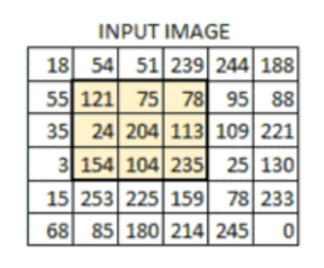
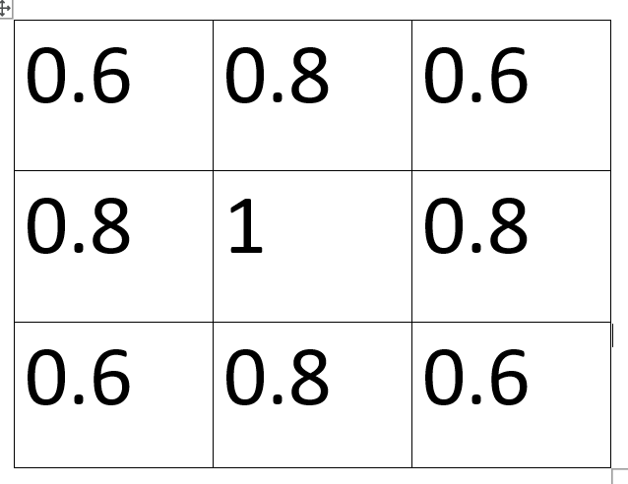
convolution kernel is set to 3*3(in terms of Gaussian filtering, the value of the kernel is set to be larger the closer it is to the centre)
3*3 region is drawn in the matrix of the image
The 3*3 kernel performs a weighted average of the 3*3 images region, pixel value changed
Sliding processes the whole image, so smoothing these very small points

Slide 23
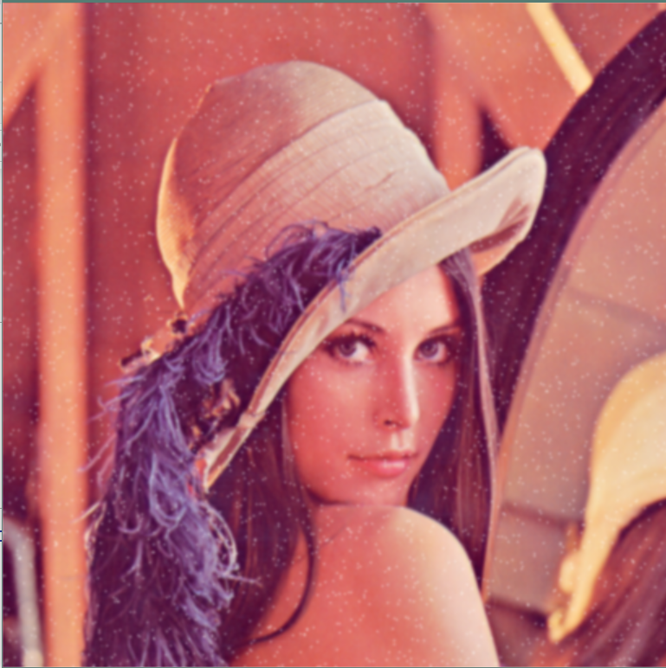
May damage the integrity of some small region, which may have an impact on images with such as HIC heatmap interaction region.
Some of the other edge detection method also have morphology method like Opening and Closing operations processing that will erode or inflate these small regions and may also affect pixel points.

Slide 24
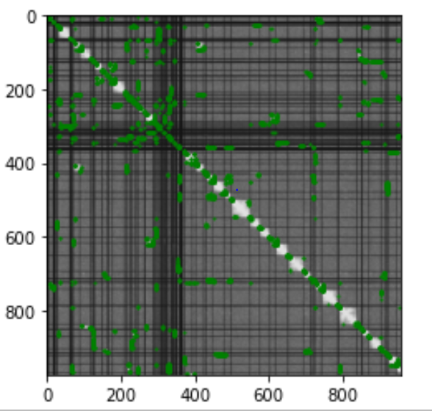
Trying to find all white pixels except those in the diagonal(haven’t finish)

Slide 25
how to reverse the location of content in the text from the pixel with dots on the image?
these points are represented in the image as pixel points and the extracted positions are at most which rows and columns of a matrix(e.g.[340,560])
If the input image is 1000*1000, there are only 1000000 pixel points, but there are likely more than 1000000 interaction points on a HIC heatmap.
Question

Slide 26
Grayscale images are easy to process and it’s hard to find Gradient for colour one.
Each mistake has a different shade of colour, making it difficult to apply a uniform standard for filtering.which can damage some information during image processing.
Is ok Border detection can filter out some information? And how to use border detection find mistakes?
Question

